Slide 1
Action TD1002
European network on applications of Atomic Force Microscopy to NanoMedicine and Life Sciences (AFM4NanoMed&Bio)
Management Committee Meeting
Dubrovnik, 27 September 2013
Gabriela Cristea
Senior Administrative Officer

Slide 2
Content
Report from the COST Office
News from the COST Office
Status of Action, including participating countries
Budget Status, budget planning and allocation process
Managing the end of your COST Action

Slide 3
News from the COST office
COST Staff responsible for your Action: - Science officer: Dr. Giuseppe Lugano - Admin officer: Ms. Anja Van Der Snikt
COST is recruiting scientists to join its pool of external experts from all scientific areas to participate in the evaluation of Open Call proposals and in the assessment of ending Actions. http://www.cost.eu/experts
BMBS APC 2014 will take place in: Malta, 28-29 April 2014.
MPNS APC 2014 will take place in:
Greece, 9-10 September 2014.

Slide 4
Status of the Action TD1002
Action update since 1st MCM (13/12/2010)
Start of Action: 13/12/2010
End of Action: 12/12/2014
No.of countries: 24
Rapporteur BMBS DC: Prof Pavle Andjus (RS)
Rapporteur MPNS DC: Prof Spiros Anastasiades (EL)
Webpage: links to the new Vademecum need to be updated

Slide 5
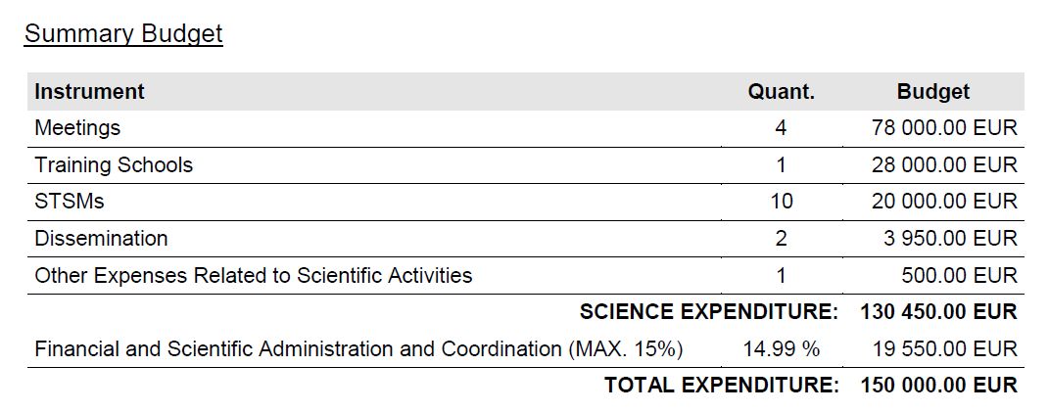
Budget status - 3rd Grant Period

Slide 6
Overall Budget status 01/01/2011- 12/12/2014
Gran Period | Grant Amount (EUR) | Actual Spending (EUR) | Under Spending (EUR) | Note
01/01/2011-31/12/2011 | 70.400 | 68.750 | 1650
01/01/2012-31/12/2012 | 142.600 | 134.074 | 8.525
01/01/2013-31/12/2013 | 150.000 | 149,473 | NA | (this figure is based on the IFR submitted in begin Sept.)
01/01/2014-12/12/2014 | 156.000 | NA | NA | new WBp to be submitted to SO by end Oct.

Slide 7
Ending an Action: General points
Training schools and STSMs can only take place within the lifetime of the Action
A Final Meeting is a wrap-up of the Action’s activities and signals the end of the Action
The Final publication is paid from the General COST budget, not from the Action’s budget

Slide 8
Ending an Action: Final Meeting
Before the Final Meeting:
6 months in advance, date and location to be agreed with SO and Rapporteurs
at least 2 weeks prior to the Final Meeting, a draft Final Scientific and Financial Report to be submitted to the Expert Panel.
Expert panel (DC Rapporteur, SO, 1-2 external experts)
No other activities are permitted after the Final Meeting.

Slide 9
Ending an Action: Final Meeting
During the Final Meeting:
general Action presentation - MC Chair
budget allocation and implementation overview – GH
WG progress reports – WG leaders
Rapporteurs’s reports – 2 DC Rapporteurs
For complete details, see Vademecum – 1.4.2. Action final assessment and final scientific report (page 12)

Slide 10
Ending an Action: Final Evaluation Report
I. Management Report
prepared by the Grant Holder
II. Final Scientific Report
prepared by the Chair of the Management Committee (using cumulative Monitoring Progress Report template) within 4 months after the end of the Action
III. Evaluation Report
prepared by the Evaluation Panel established by the Domain Committee and edited by the Rapporteur
IV. DC Remarks
prepared by the Domain Committee

Slide 11
Ending an Actions: what you are evaluated on
Results versus objectives
Innovative networking
Inter-disciplinary networking
New networking
Coordination and management
Strengths and weaknesses

Slide 12
Ending an Actions: Final Publication
Amount:
The COST Office will finance the final publication for an amount of up to 10.000€. (excl. VAT)
Steps to be followed:
MC decision and official request from Chair to SO
SO approval
Validation of request by COST Head of Communication
Publisher offer sent via the MC chair
Purchase Order
Print release
Delivery and Payment.
For complete details, see Vademecum – 8.2. Final Action publication (page 43)

Slide 13
Ending an Actions: Final Publication
Eligible costs:
production and distribution cost of a publication by a printing
house or for the creation and/or distribution of alternative dissemination tools,
purchase and distribution of a fixed number of copies of high-quality publications produced by a renowned publisher (usually books or journals);
proofreading, editing, production and distribution costs relating to the production of publications and dissemination tools;
Non-eligible costs:
graphic design
translation,

Slide 14
COST Office Contact Point Action TD1002
Science Officer Dr Giuseppe Lugano giuseppe.lugano@cost.eu
Tel: 32 (0)2 533 38 22
Administrative Officer Ms Anja Van Der Snikt anja.vandersnikt@cost.eu
Tel: +32 (0)2 533 38 46

